Slide 1

ABP Studio
The Missing Tool for .NET Developers

Slide 2

Agenda
What is ABP Studio? Why We’ve Built it?
Demo
Installation & Overview
Basics: Creating solutions / Using ABP & .NET CLI commands
Building modular & complex applications
Developing, running and monitoring distributed dystems
Working with Kubernetes
Working with ABP Suite
.NET Aspire?
Road Map
Licensing
Next ABP Studio Events

Slide 3
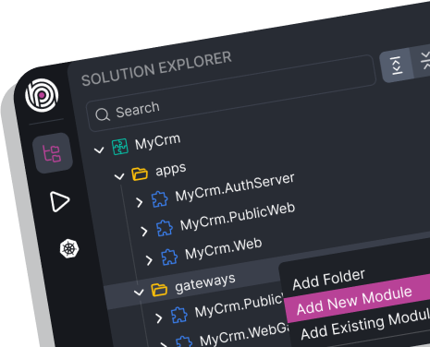
ABP Studio: What it is?
A cross-platform desktop application for ABP developers
A tool you use daily to simplify or automate your non-coding activities
It is not a coding IDE (e.g. Visual Studio)

Slide 4
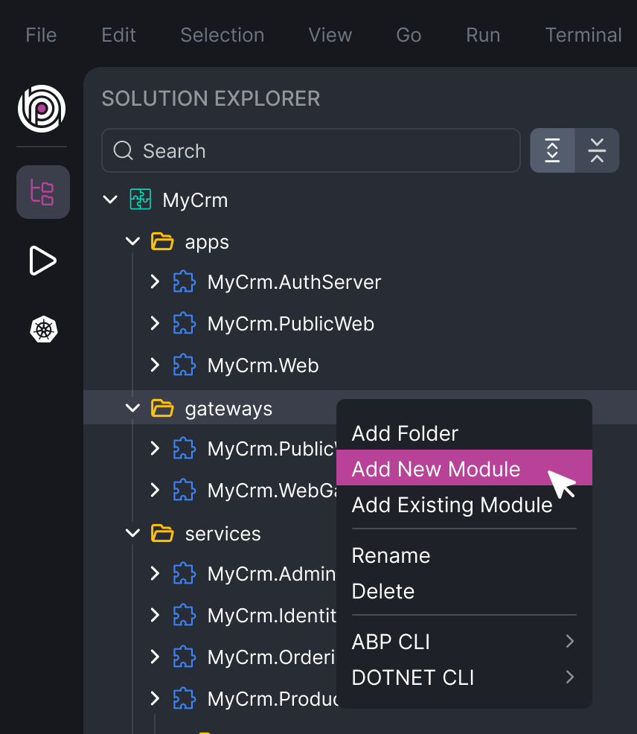
ABP Studio: Why?
A single wiew of a system consists of multiple .NET solutions
Architecting complex software solutions
Modular monoliths
Microservice / distributed systems
Building & managing multi-package or layered modules
Install, uninstall and explore external modules

Slide 5
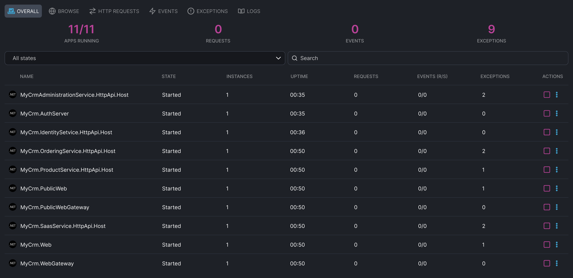
ABP Studio: Why?
A single UI to control multi-application solutions
Running multiple applications/services with a single click
Browse, monitor, trace and debug problems across applications/services

Slide 6
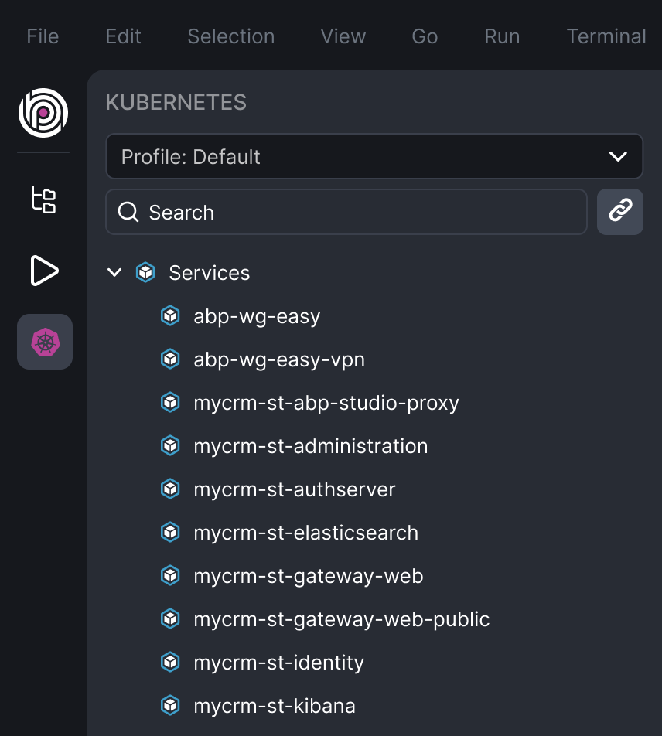
ABP Studio: Why?
A comfortable development environment for Kubernetes
Seemlessly integrate your local environment to a Kubernetes cluster
Access internal services
Intercept traffic to run, debug and develop a service in your local environment

Slide 7
DEMO

Slide 8
ABP Studio vs .NET Aspire
Feature | ABP Studio | .NET Aspire
Integration Packages (Dapr, Redis, RabbitMQ, MongoDB, etc) | YES (rich and well-integrated abstractions) / ABP Framework | YES (simple abstraction and integrations)
Starter Templates | YES (avdanced architecture & options) | YES (simple)
Monitoring | HTTP Requests, Events, Exceptions, Logs | Metrics, Traces, Logs
Architecting / Building Solutions | YES | -
Application Runner | YES | -
Kubernetes Tunneling | YES | -
Building Modular Solutions | YES | -

Slide 9
ABP Studio: Road Map
UI Theme Builder
Customizing Re-used Application Modules
Internal & Public Module Stores
More Deployment Options
Analyzing Your Solution & Smart Best-Practice Suggestions
Rapid Application Development System
Any feature request: info@abp.io

Slide 10
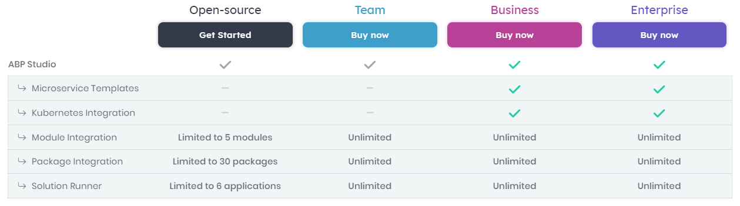
ABP Studio: Licensing

Slide 11
ABP Studio: Next Planned Live Events
Developing Modular Monolith Applications
Developing Microservice Applications & The Microservice Startup Template

Slide 12
? questions

Slide 13
Topic title
Content

